Slide 1


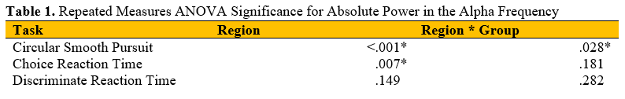
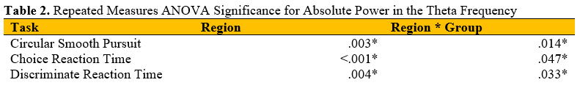
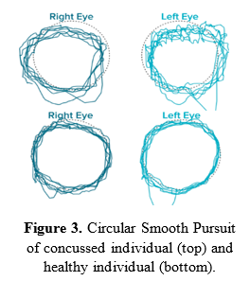
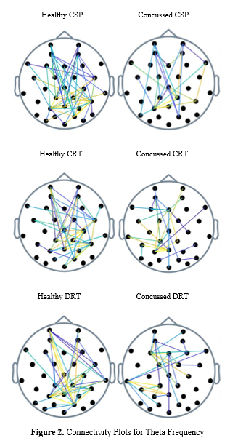
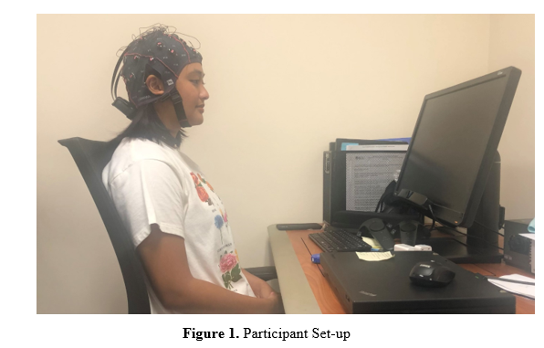


Circular Smooth Pursuit Assessment and Neuronal Activity in the Alpha Frequency as Predictors of mTBI
Elizabeth Breitbach¹, Joshua Lawton², Riley Warlick², Melissa Hunfalvay³, Nicholas P. Murray²
¹Department of Chemical Engineering, University of Minnesota Duluth, Duluth, MN, USA; ²Department of Kinesiology, East Carolina University, Greenville, NC, USA; ³RightEye, Bethesda, MD, USA
INTRODUCTION
RESULTS
DISCUSSION
An estimated sixty-nine million individuals suffer from traumatic brain injuries each year, contributing heavily to death and disability [1].
Accurate and timely detection and diagnosis are essential to preventing debilitating and long term consequences.
Many traditional diagnostic methods are subjective, unreliable, and rely on patient cooperation.
Assessment of oculomotor control can identify dysfunction in neuronal activity indicative of a brain injury.
Previous research has suggested that circular smooth pursuit and reaction time tasks can be used as biomarkers for TBIs [2].
Repeated Measures ANOVA
Analysis was conducted on the influence of concussed status and brain region on absolute power in both the alpha and theta frequencies for three visual tasks: circular smooth pursuit (CSP), choice reaction time (CRT), and determinate reaction time (DRT).
Significant main effects for region and interaction effects between region and group were demonstrated and are shown below with an asterisk.
Multivariate ANOVA
MANOVAs were conducted on the influence of concussed status on neuronal activity and oculomotor metrics generated from the Dynamic Vision Test.
The MANOVA on CSP metrics in the alpha frequency revelated a significant multivariate effect, Wilks’ lambda, Λ = .000, F(25,1) = 553.81, p = .034.
The MANOVA results for all other tasks were not significant.
The results indicate the combination of circular smooth pursuit assessment and neuronal activity in the alpha frequency have the potential to be a successful diagnostic tool for TBIs.
The ANOVA results indicate a difference in power between regions of the brain during most tasks and an interaction effect between concussed status and power in some tasks.
Differences in connectivity in the theta frequency may be indicative of neuronal dysfunction in the anterior cingulate, the region of the brain responsible for theta rhythm.
PURPOSE
The purpose of this project was to study the differences in brain activity and oculomotor control in concussed individuals compared to healthy individuals and determine if the combination of these metrics could predict head injury.
MATERIALS & METHODS
Discriminant Analysis
Conducted to determine whether brain activity expressed by absolute power and visual performance measurements could predict the presence of a head injury.
The overall Wilks’ lambda was significant, Λ = .075, χ²(22) = 36.17, p = .029.
Connectivity Plots
Connectivity plots were produced using coherence for both alpha and theta frequencies for all three tasks – CSP, CRT, and DRT.
Plots using alpha frequency showed little to no connectivity differences between concussed and healthy individuals.
Plots using theta frequency showed less connectivity in concussed individuals compared to healthy individuals (right).
Data from 10 concussed participants (age: 20.2 ± 1.87 yrs, post-injury: 8.0 ± 3.96 months) and 17 healthy participants (age: 20.7 ± 1.68 yrs) were analyzed.
Concussion history was self-reported. All concussed individuals had sustained their head injuries in the last 13 months.
Each subject was fitted with a 32-channel dry g.tec EEG cap and neuronal activity was recorded using g.Recorder software (Guger Technologies, Austria) and analyzed in MATLAB programming (MathWorks, USA).
All participants completed the Dynamic Vision Test (RightEye, LLC, MD, USA) consisting of smooth pursuits (circular, horizontal, vertical), saccades (horizonal, vertical), fixations, and reaction time tasks (choice, discriminate).
FUTURE WORK
More research should be conducted to understand the effects of post-injury length, severity of injury, and frequency of injury on the results.
REFERENCES
[1] Dewan, M. et al. Journal of Neurosurgery. (2019). 130(4) 1080-1097.
[2] Hunfalvay, M. et al. Frontiers in Behavioral Neuroscience. (2020).
ACKNOWLEDGEMENTS
This material is based upon work supported by the National Science Foundation under Grant No. 1950507. Any opinions, findings and conclusions or recommendations expressed in this material are those of the author(s) and do not necessarily reflect the views of the National Science Foundation.
NSF REU: Biomedical Engineering in Simulations, Imaging, and Modeling (BME-SIM)
Add me on LinkedIn!
go.ecu.edu/BME-SIM
Notes:
Please be sure to include all authors and institutions/affiliations
Can add your school-approved logo

